Slide 1
CellProfiler 202
Ruofan Yu
11/14/2024

Slide 2
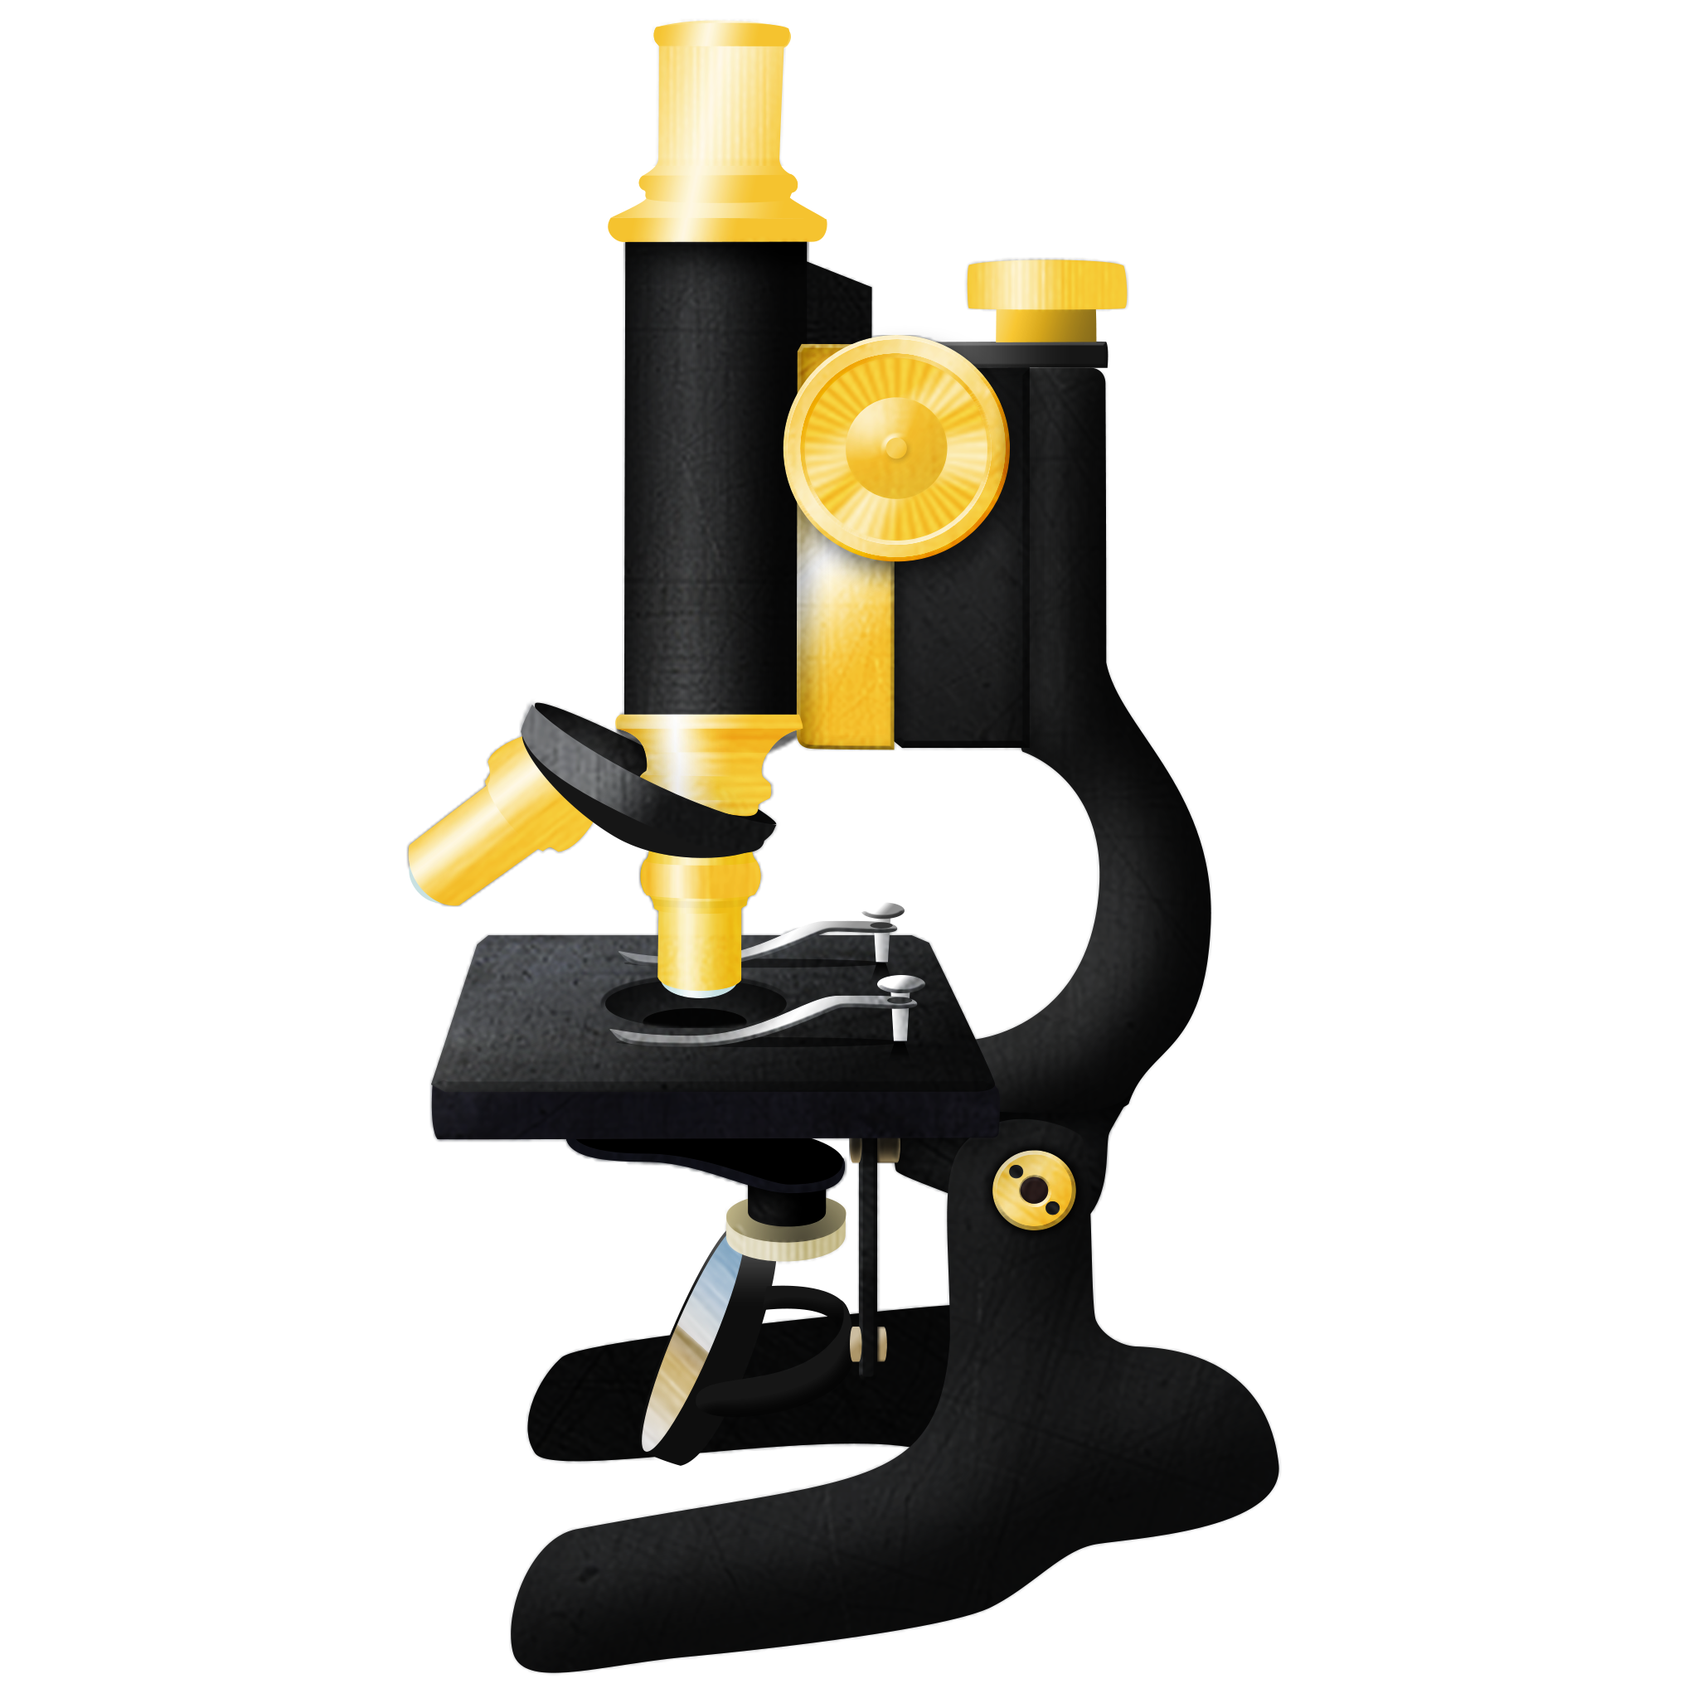
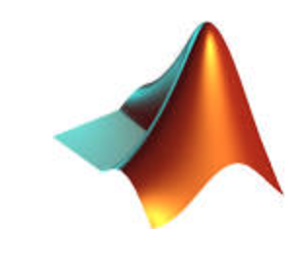

Tools we use for image analysis
ImageJ/FIJI
MATLAB
CellProfiler
Able to perform nearly any kind of analysis there is.
Limited batch analysis ability.
Highly customizable if one knows MATLAB coding, compatible with automatic pipeline.
Requires some knowledge/practice before one can master.
Customizable, easy to learn, easy to perform batch analysis, compatible with command line.
Limited ability to perform certain task: e.g. smRNA-FISH.

Slide 3

CellProfiler is an open-source image analysis software
First released in 2005 by Whitehead/MIT
Free and open-source, available for Win, Mac and Linux
Cited in >1000 paper per year

Slide 4
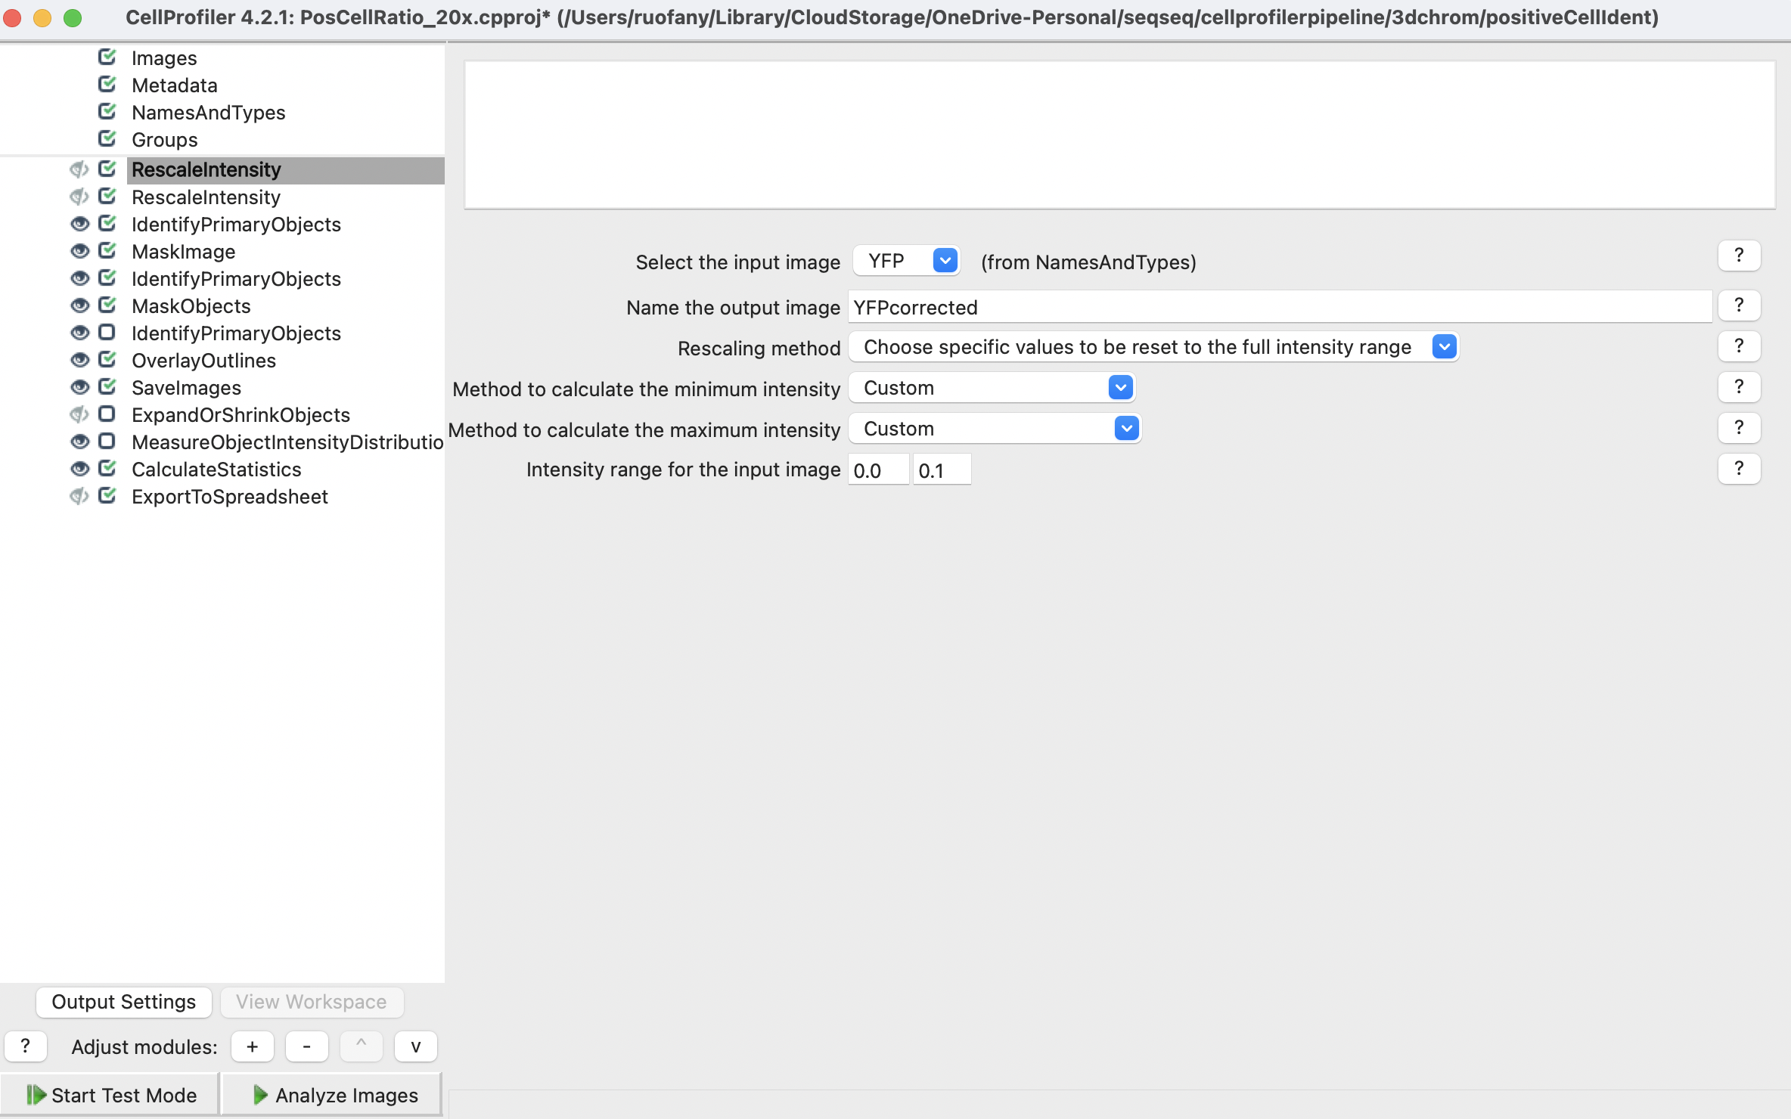
Before start..
When in doubt
Click help button
Check CP manual: https://cellprofiler-manual.s3.amazonaws.com/CellProfiler-4.2.8/index.html

Slide 5
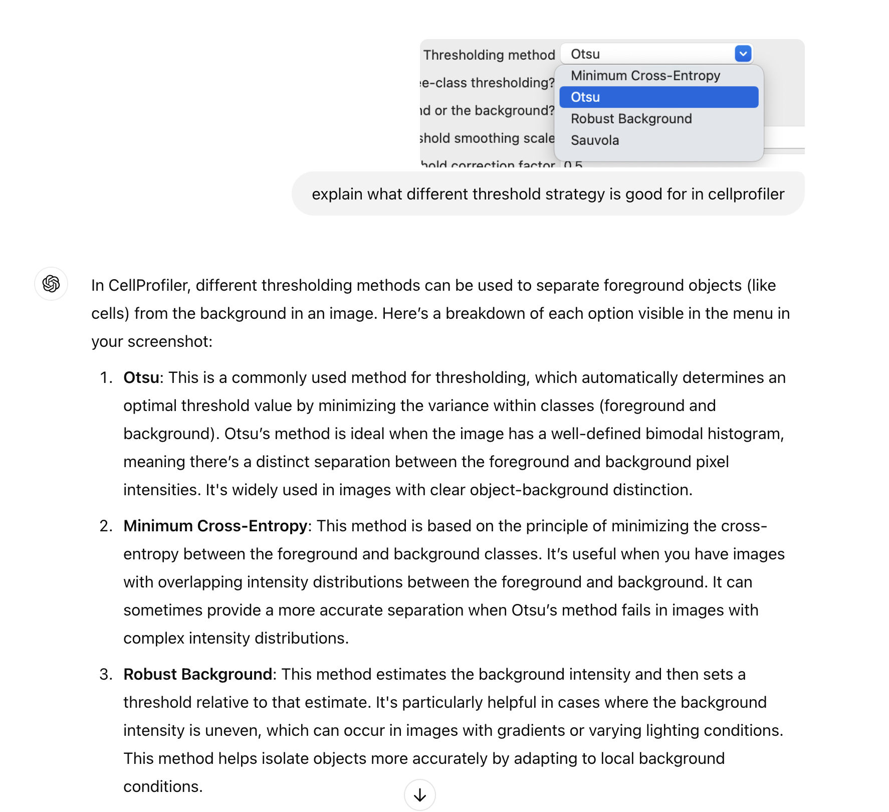
Before start..
When in doubt
Click help button
Check CP manual: https://cellprofiler-manual.s3.amazonaws.com/CellProfiler-4.2.8/index.html
.. ask someone, like me, or chatgpt.

Slide 6
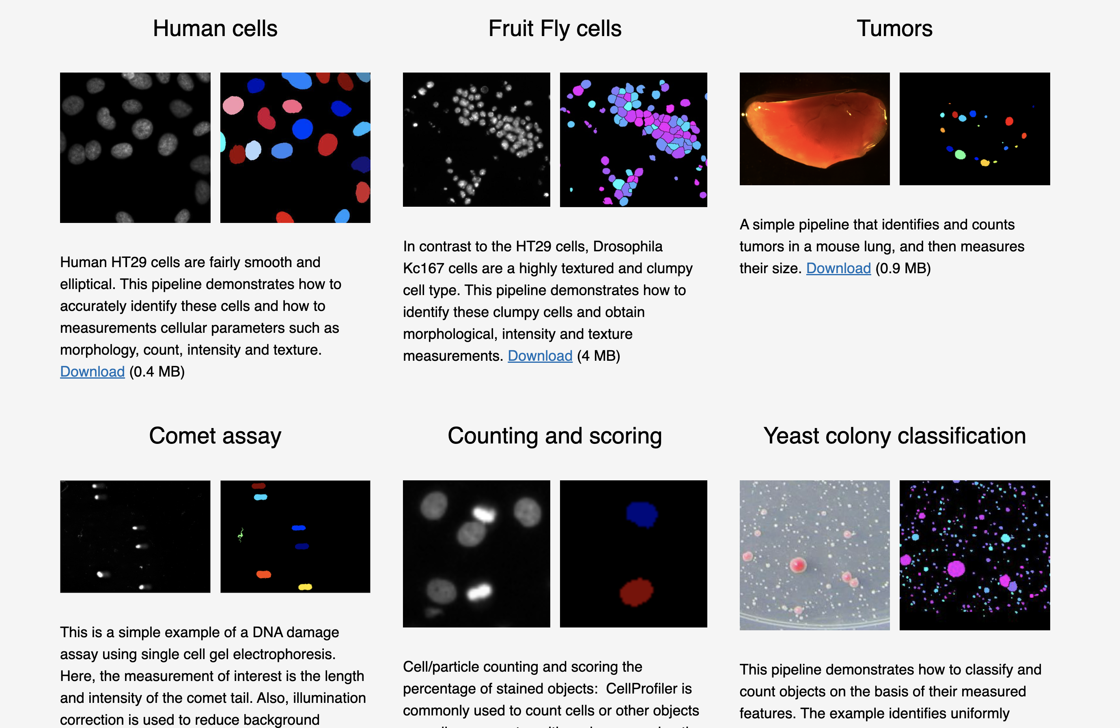
Before start..
Sample pipeline:
CP website: https://cellprofiler.org/examples
My git: https://github.com/Chalietia/CellProfiler/tree/main

Slide 7
1. loading data
Tiff/png etc. image file
.nd2 superstack from Nikon scope with metadata
Needs to be converted to tiff etc. in a separate pipeline.
Specify how the stack is organized.

Slide 8
2. Saving data
SaveImages
Processed image files
ExportToSpreadsheet
To export measurements such as size/location/intensity

Slide 9
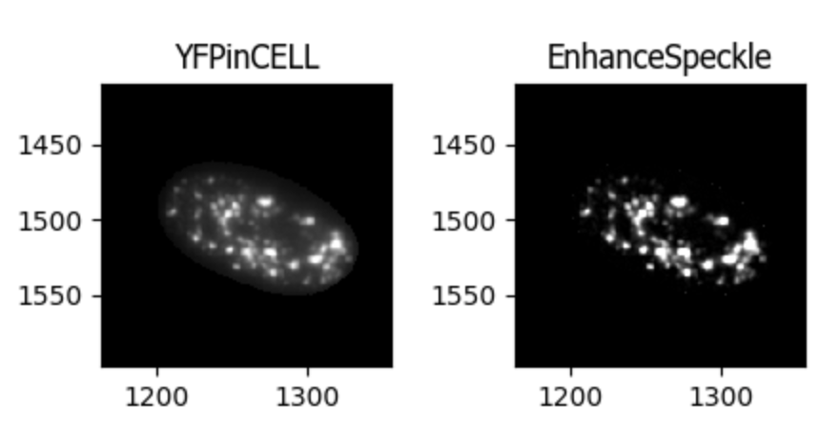
3. Common image processing
Image Projection:
MaxIntensity Projection
MinIntensity Projection
Rescale intensity
EnhanceOrSuppress features
When different sized objects/noise present
EnhanceOrSuppress:

Slide 10
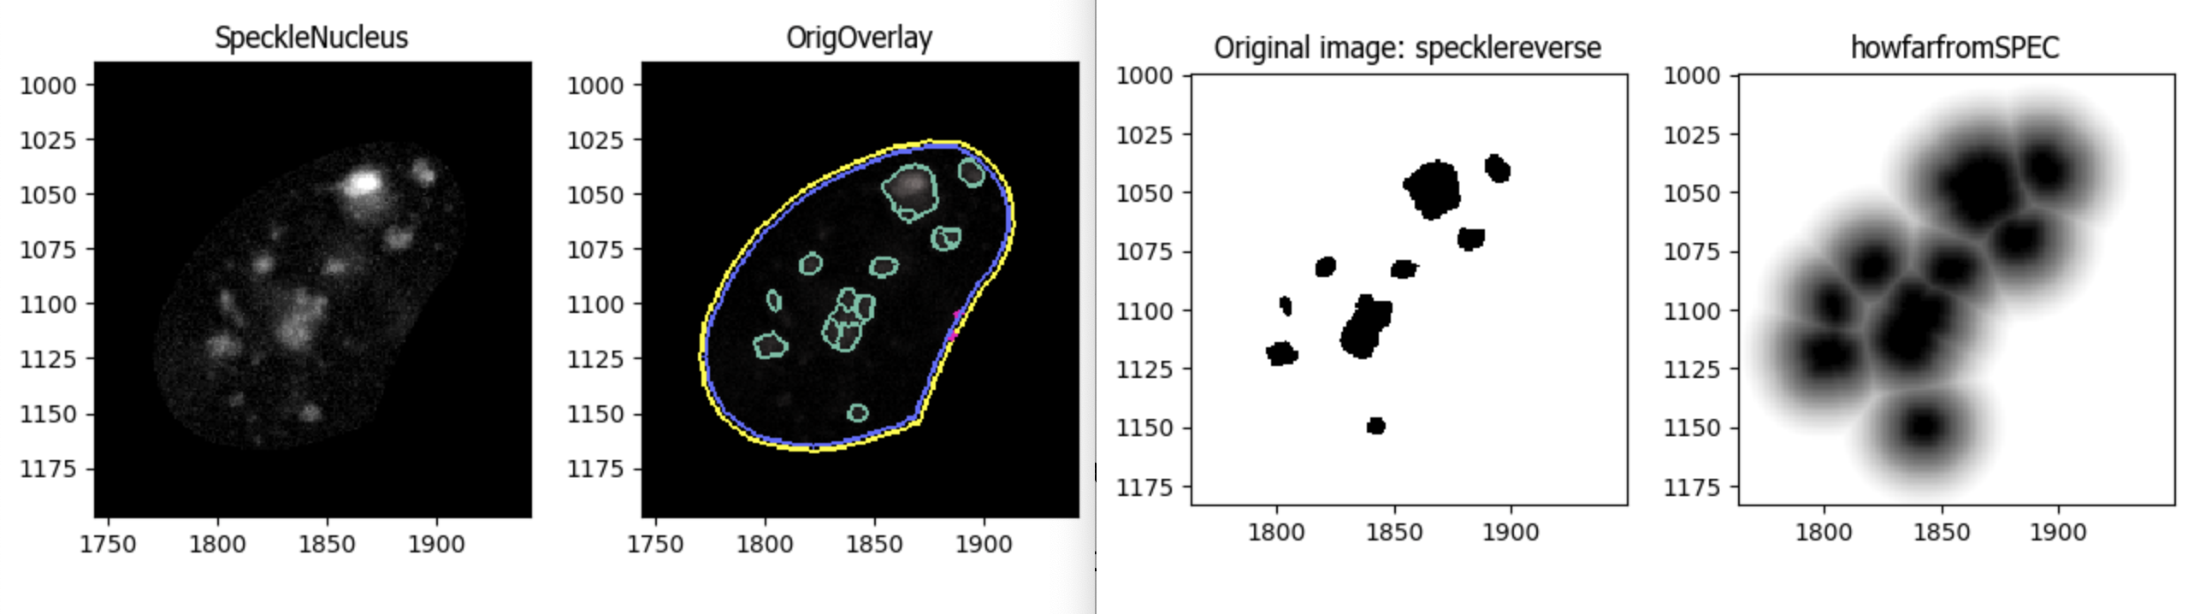
3. Common image processing
ImageMath and Morph
Subtract/normalize against a background
Example use of morph:
Measure distance to object rim.
(center-to-center distance can be measured directly by MeasureObjectNeighbors)

Slide 11
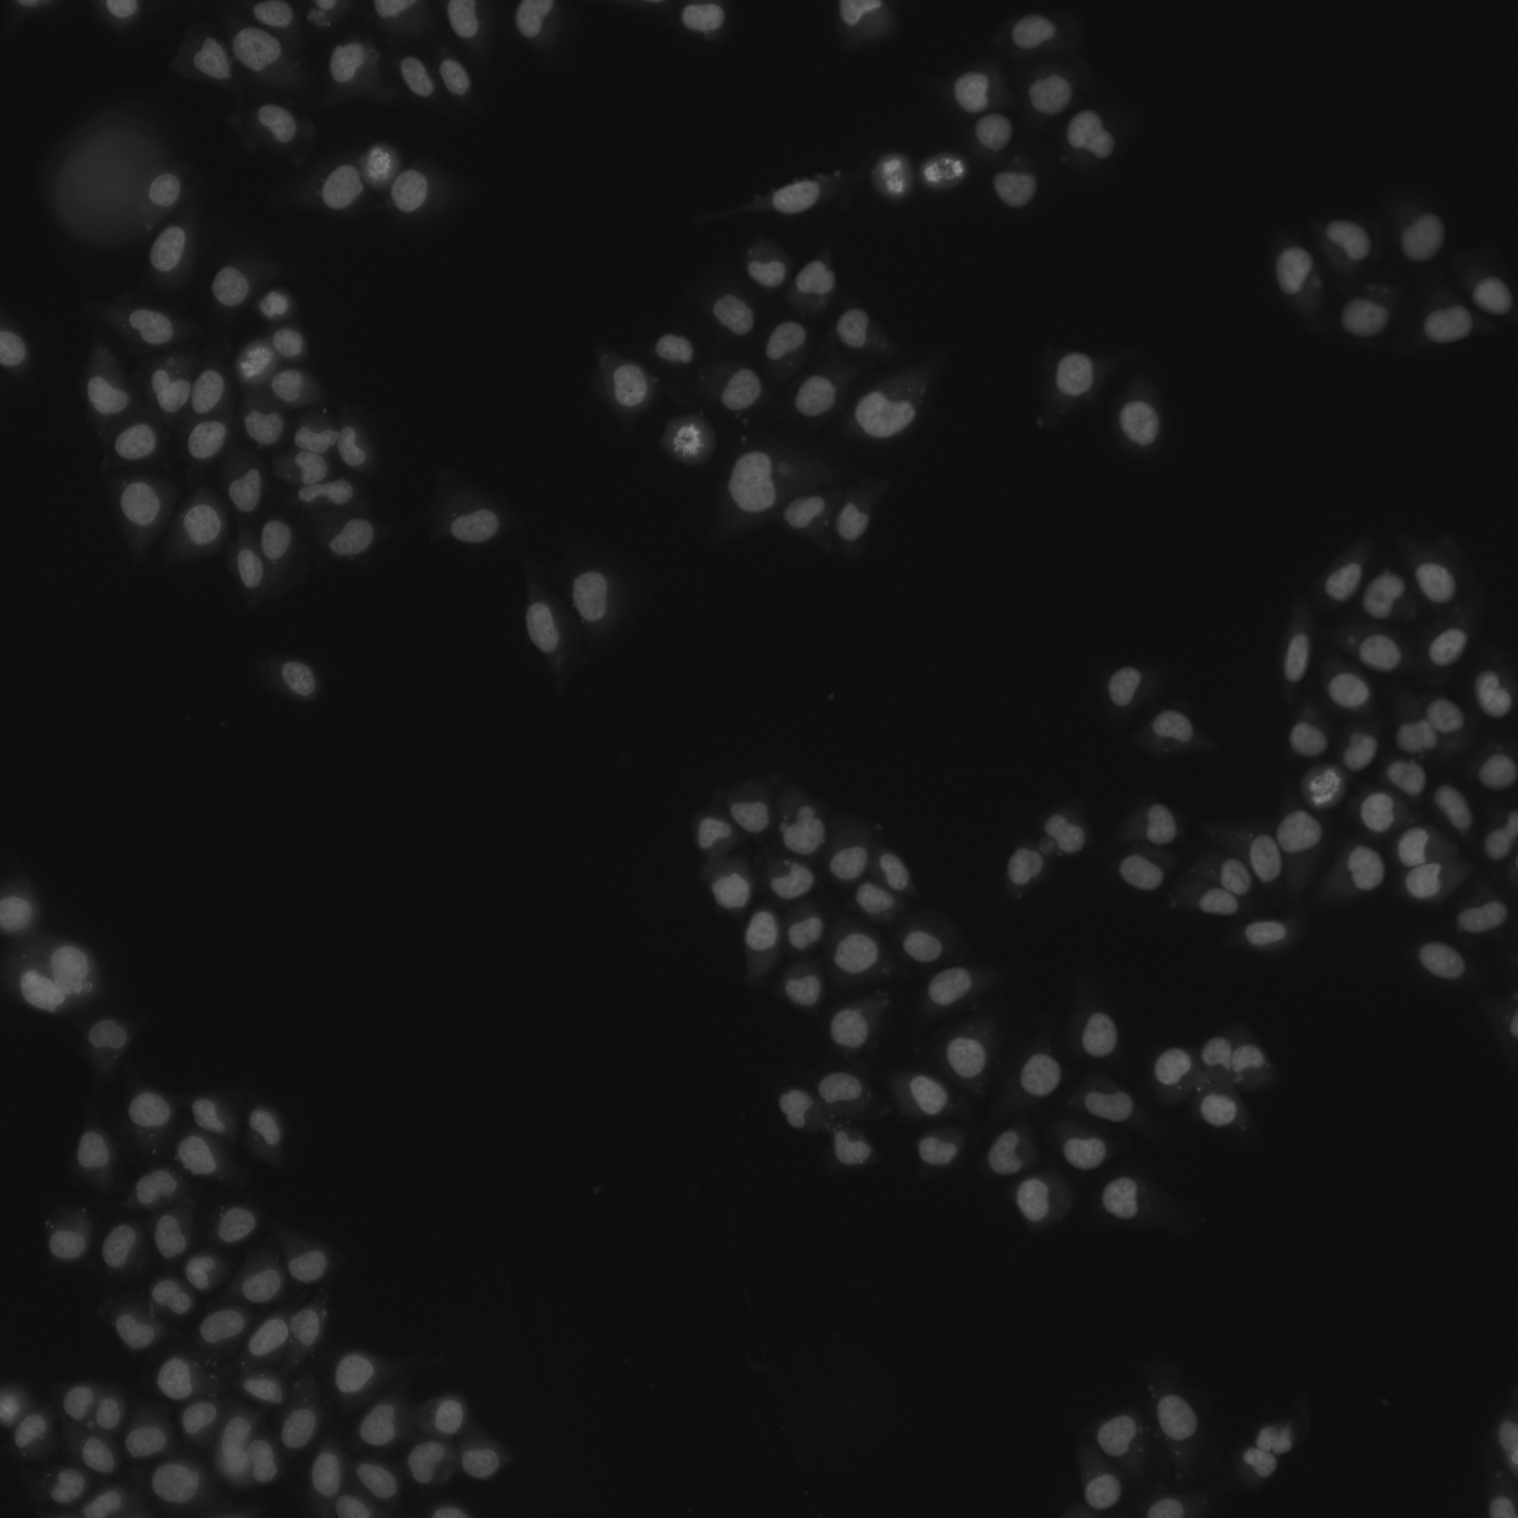
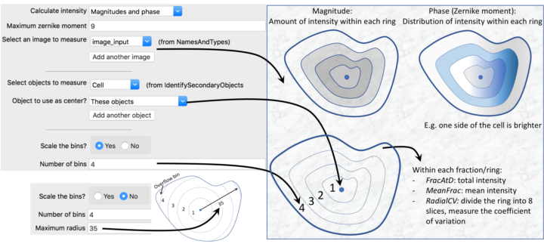
4. Image measurement
Colocalization Texture Intensity distribution

Slide 12
5. Object identification/masking/relating
IdentifyPrimaryObjects
Most important function, identify nucleus/speckle/FISH foci etc.
Various methods and parameters, I typically start with Otsu.
MaskImage
MaskObjects
RelateObjects
Establish parent-child relationship (e.g. nucleus-speckle), so parent/child measurement can be exported together.
Identify/EditObjectsManually

Slide 13
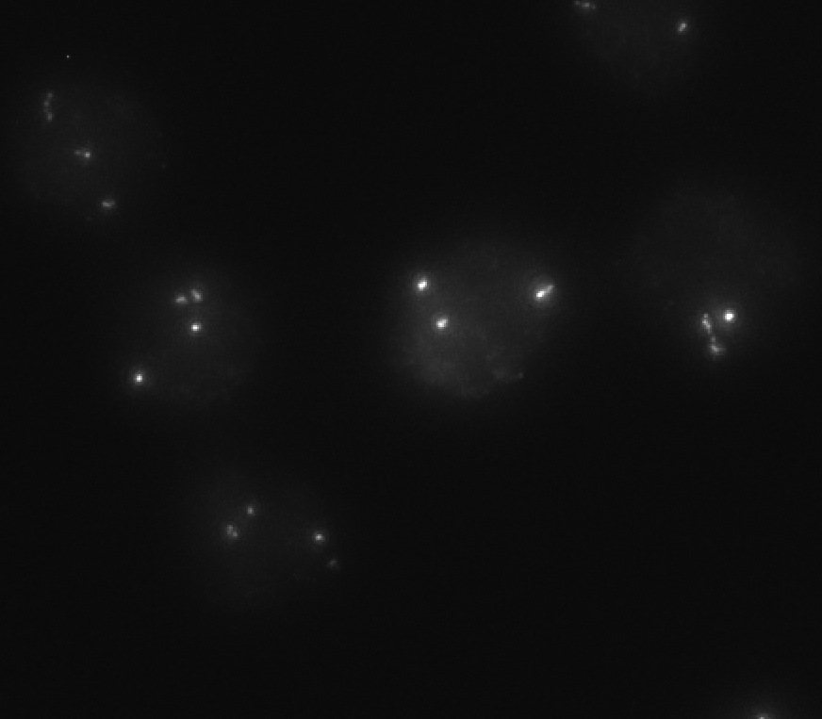
5.1 thresholding
Strategy
Global: even intensity across view
Adaptive: uneven
2. Method
Otsu: Good starting point for segmenting cells (DAPI)
Minimum Cross-Entropy: local, smaller object (speckle)
Robust Background:
Sauvola: Very local, for small foci (FISH)

Slide 14

6. Running CellProfiler with command line
CP can be installed via pip/conda, or Docker
Docker is very simple
Helpful when processing multiple sets of data with the same pipeline
see https://github.com/Chalietia/CellProfiler/blob/main/DockerCP.sh
maxp/
└── sample1/
│ ├── tiff1.tiff
│ ├── tiff2.tiff
│ └── ...
|
└── sample2/
│ ├── tiff1.tiff
│ ├── tiff2.tiff
│ └── ...
|
└── sample3/
├── tiff1.tiff
├── tiff2.tiff
└── ...

Slide 15
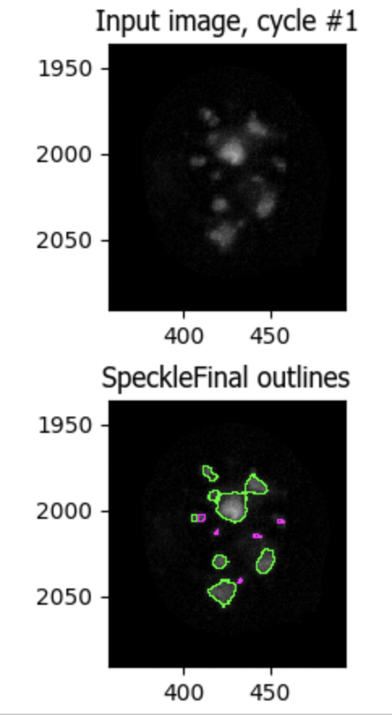
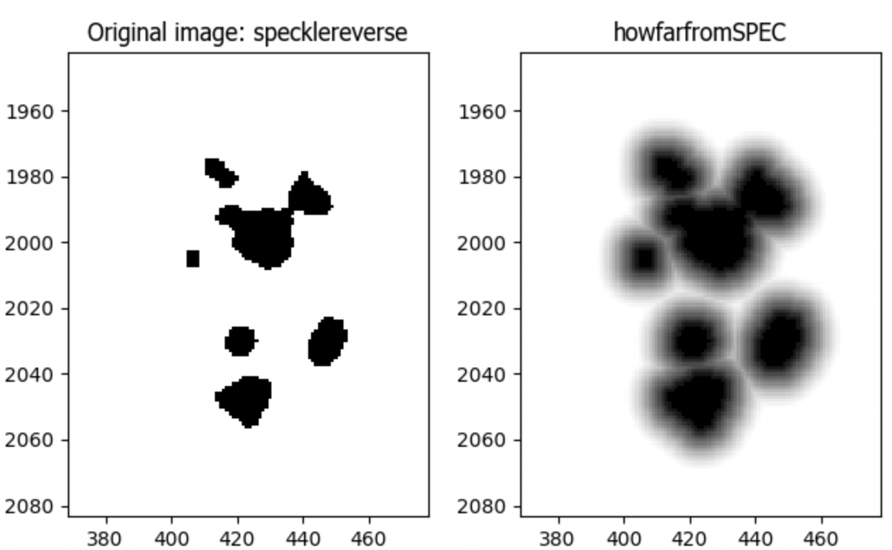
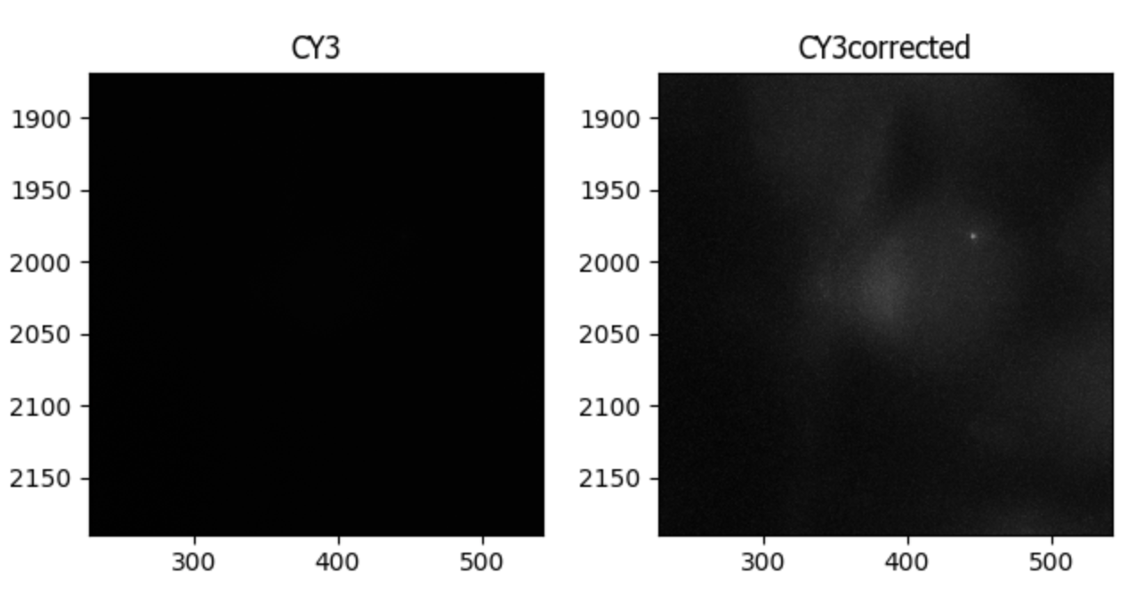
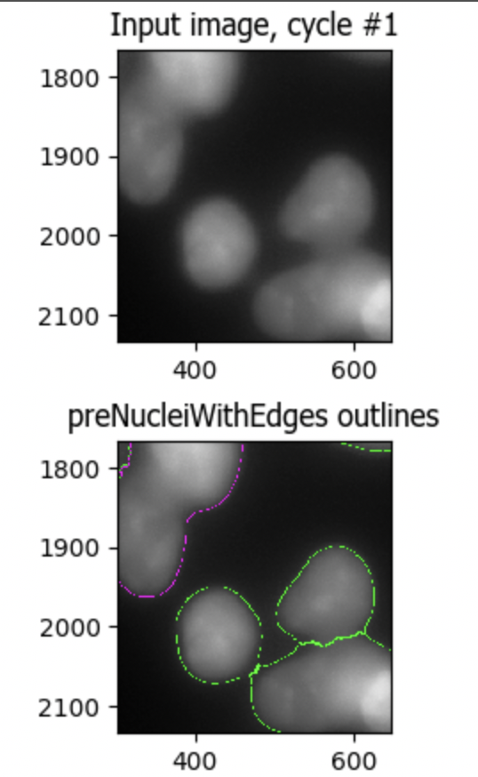
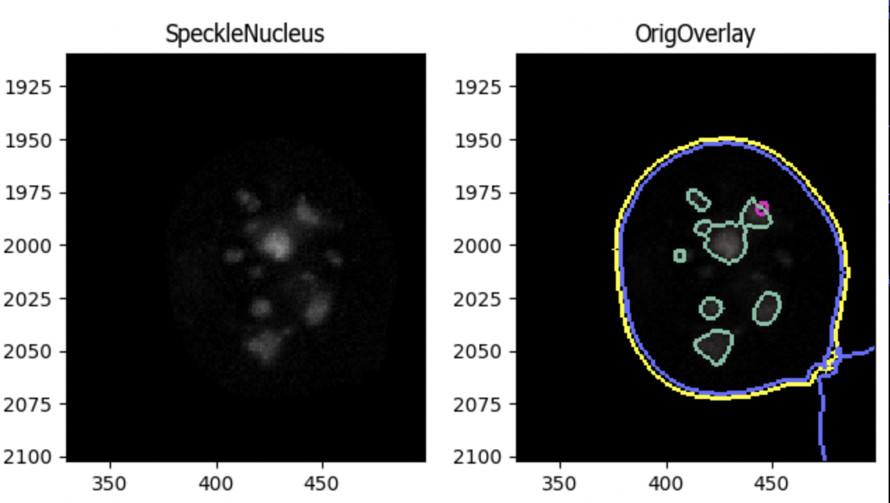
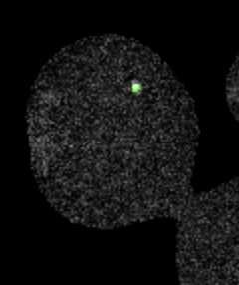
7. Example pipeline: Measure DNA-FISH foci-speckle distance
Distance: 0px
Intensity adjustment
Identify cell nucleus
Mask-Enhance-call DNA-FISH
Mask-Enhance-call speckle
Relate speckle, foci to cell
Calculate distance and other metrics & Save overlay image
4
1
2
6
Overlay
5
3

Slide 16
8. Cautions
Check projected data beforehand and get rid of problematic ones
May not work with less-than-optimal data.
(It’s not magic)
Parameters of thresholding etc. may require adjustment for each dataset.
particularly, thresholding and diameter
Always save images showing object calling
Keep the pipeline used for each dataset

Slide 17
Check RY’s GitHub page for more pipelines/instruction: https://github.com/Chalietia/CellProfiler

